Slide 1

Regression Analysis
SPY - AMZN
By Paulami Patil

Slide 2
Content
SPY Holdings
Patterns and Trends in Historical Return
Model Evaluation
Forecast return
Summary
Conclusion

Slide 3
SPY Holdings
Name | Ticker
APPLE INC | AAPL
MICROSOFT CORP | MSFT
AMAZON.COM INC | AMZN
NVIDIA CORP | NVDA
ALPHABET INC CL A | GOOGL
META PLATFORMS INC CLASS A | META
TESLA INC | TSLA
ALPHABET INC CL C | GOOG
BERKSHIRE HATHAWAY INC CL B | BRK.B
UNITEDHEALTH GROUP INC | UNH

Slide 4
Historical Returns

Slide 5
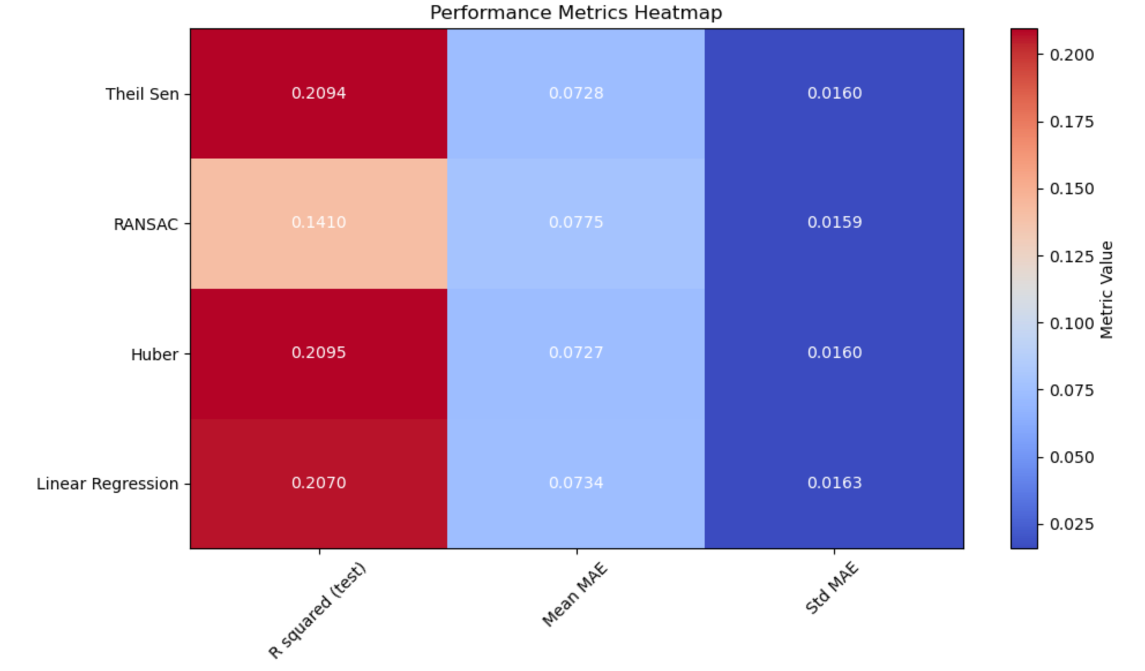
Model Evaluation
Linear Regression model displays a high Beta of 1.5498, indicating strong sensitivity to market movements relative to AMZN.
The Huber model has a relatively higher R squared value (0.2095) compared to other models
The Huber model has a lower mean absolute error (Mean MAE: 0.0727) and standard deviation of MAE (Std MAE: 0.0160), indicating that the Huber model's predictions are, on average, closer to the actual values, and the prediction errors are more consistent.
Since the Theil Sen model is known for its robustness and resistance to outliers, the Huber model could balance robustness and predictive performance.

Slide 6
Forecast Return
The forecasted returns from the Huber model is less than that of Linear Regression
Huber Regressor is less sensitive to outliers and sometimes captures the underlying data distribution and relationships more effectively.
The two models have different levels of flexibility. Linear Regression tries to find the best-fitting linear relationship. At the same time, Huber might capture more complex relationships if present in the data.
Investors seeking a more risk-averse approach might find the Huber model's conservative forecasts appealing, which could lead to adopting a safer investment strategy based on the model's projections.

Slide 7
Strategy Performance
AMZN has a relatively low annualized volatility of 0.34, suggesting that despite not generating a return, the investment experiences lower price fluctuations than SPY and strategy.
The Sharpe ratio for AMZN is 0.01, indicating that the risk-adjusted return for this investment is low due to the absence of positive returns.
The strategy demonstrates consistent performance with the same annualized return and volatility as the broader market (SPY), indicating that the strategy's returns and risk characteristics align with the market.
The annualized volatility for strategy and SPY is the same at 13.49, indicating that the strategy's risk level is consistent with that of the broader market represented by SPY.
 | Annualized Return | Annualized volatility | Sharpe Ratio
Strategy | 0.95 | 13.49 | 0.07
AMZN | 0 | 0.34 | 0.01
SPY | 0.95 | 13.49 | 0.07

Slide 8
Summary
AAPL, MSFT, and other large-cap tech stocks significantly influence SPY's composition and performance due to their substantial weightage. The performance of these stocks can sway the overall ETF's performance.
AMZN's historical cumulative returns have been volatile, reflecting its growth trajectory and market sentiment.
SPY's returns also fluctuate with market conditions, showcasing periods of both growth and decline.
Huber's better performance in terms of MAE and prediction accuracy suggests its potential utility in predicting future SPY returns.
Incorporating Huber's forecasted returns into long-term portfolio simulations can provide insights into the potential cumulative performance over time. This information aids in evaluating the sustainability of investment strategies.
AMZN's low volatility implies stability, but its absence of positive returns affects its risk-adjusted performance (Sharpe ratio)

Slide 9
Conclusion
Our strategy and the broader market represented by SPY exhibited similar risk-adjusted performance, suggesting a balanced alignment.
Among our regression models, Huber's superior predictive accuracy was demonstrated by lower MAE and Std MAE, suggesting its potential to generate more robust forecasts for future returns.
The historical cumulative returns of both AMZN and SPY show periods of positive and negative growth. While the specific trends differ, there are instances where both assets experience growth simultaneously, indicating some level of correlation.
While there is a correlation, there are also periods where AMZN's cumulative return outperforms SPY and vice versa, indicating that while there may be shared market influences, the individual stock dynamics of Amazon can result in divergent returns compared to the overall market represented by SPY.
While Amazon's lower volatility can offer some stability, its cumulative return is consistently lower than SPY's, implying a potential trade-off between lower risk (volatility) and potentially lower returns when investing in Amazon compared to the broader market.

Slide 10
Appendix
Code: Attached to submission

Slide 11
Thank You

